Slide 1
Practical 14
Practical Name: Mini-Project through Python
Practical Outcome: Applications of all the concepts

Slide 2
Task Management Project
The Task Management Project is designed to help users manage their tasks efficiently.
Group Members:
Roll No Name
A-70 Kausar Shaikh
A-71 Mahek Shahbad
A-74 Shafin Zartar

Slide 3
Functions
Introduction
Abstract
Contents
Code
Output
Register
Login
Conclusion
References

Slide 4
Abstract
The Task Management System is a comprehensive solution that empowers users to manage their tasks effectively. It offers essential functionalities such as task creation, task update, task deletion, task listing, user registration, and user login. Upon registration, users can securely log in to the system and gain access to their personalized task dashboard. The intuitive interface enables users to create tasks with detailed information such as title, description, and status. Tasks can be categorized as 'To Do', 'In Progress', or 'Completed', facilitating easy tracking of progress. Users can update task details as needed, ensuring accurate and up-to-date information. Additionally, the system allows users to delete tasks that are no longer relevant or required. The task listing feature provides a comprehensive view of all tasks, offering a holistic overview of ongoing and completed work. With the Task Management System, individuals and teams can stay organized, prioritize tasks effectively, and enhance overall productivity.

Slide 5
Introduction
The Task Management System is a software application designed to assist users in efficiently managing their tasks and improving their productivity. In today's fast-paced and dynamic work environment, staying organized and keeping track of multiple tasks can be challenging. This system provides a user-friendly interface that allows individuals or teams to create, update, and track tasks seamlessly. By centralizing task management and providing robust features, this system aims to streamline workflow, enhance collaboration, and ensure that tasks are completed in a timely manner.

Slide 6
Module
Task Management System
Login
Create new task
Update task
Register
Delete Task
View Tasks
Logout

Slide 7
Module
Register
Login
The Register functionality allows users to create an account by providing their details.
Upon registration, users can access the system using their credentials.
The Login functionality enables users to log in with their username and password.
Only registered users can access the system and manage their tasks.

Slide 8
Login Module
Task Creation
Users can create tasks by providing a title, description, and status.
Task Update
Existing tasks can be updated by modifying their title, description, or status.
Tasks can be categorized as 'To Do', 'In Progress', or 'Completed'.
Once created, tasks are stored in the database for future reference.
Users can edit tasks to reflect changes in progress or other details.
Task Deletion
Task Listing
Logout
Users have the ability to delete tasks from the database.
Deleting a task removes it permanently from the system.
Users can view a list of all tasks with their details.
The Task Listing provides an overview of all the tasks in the system.
The Logout functionality allows users to securely log out of the system.
Once logged out, users no longer have access to their tasks and account information.

Slide 9
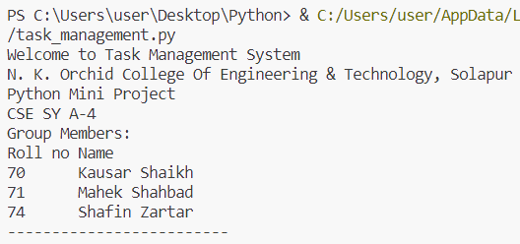
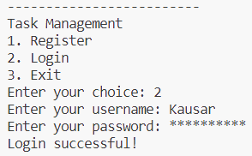
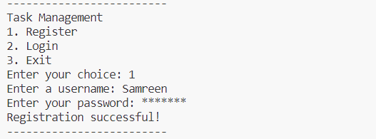
Outputs
Output: Login using existing user ID
Output: Welcome screen and Register a new user

Slide 10
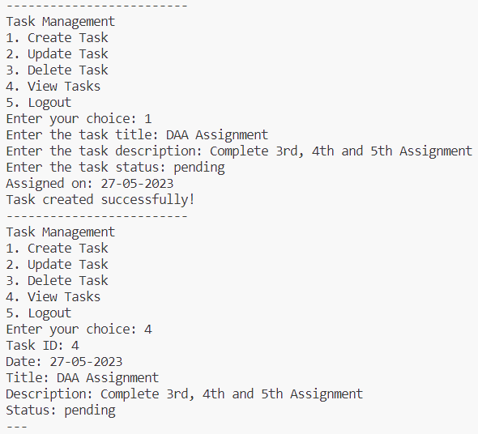
Output: Create a new task and view all tasks

Slide 11
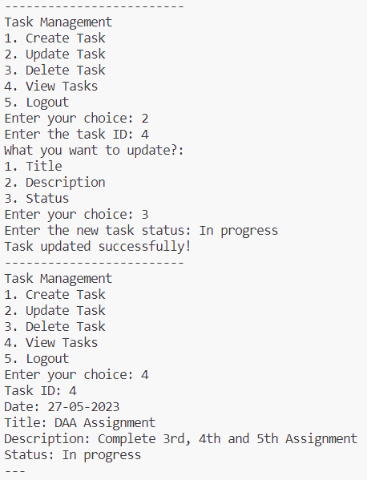
Output: Update a task and view all tasks

Slide 12
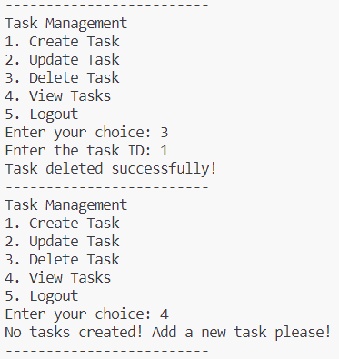
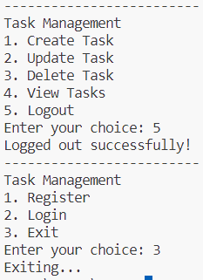
Output: Logout and exit
Output: Delete a task and view all tasks

Slide 13
Conclusion
In conclusion, the task management system provides a practical and approachable means of planning and monitoring work. Users are able to manage their tasks and maintain organization with the use of features like user registration, login, task creation, updates, and deletions. Using the SQLite database, the system offers a dependable and effective method of storing and retrieving task data. The project assists users in setting priorities for their work, working efficiently with others, and meeting deadlines by streamlining task management procedures. Overall, the task management system makes it easier to handle tasks and boosts both individual and team efficiency.

Slide 14
References
https://sqlitebrowser.org/dl/
https://www.geeksforgeeks.org/getpass-and-getuser-in-python-password-without-echo/
https://bobbyhadz.com/blog/python-username-password-input-3-attempts

